Slide 1
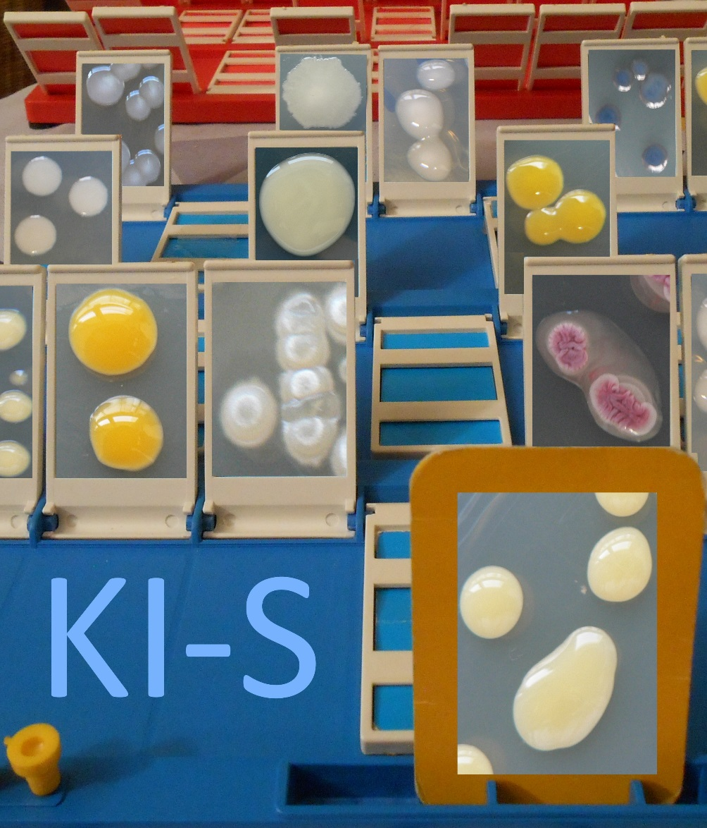
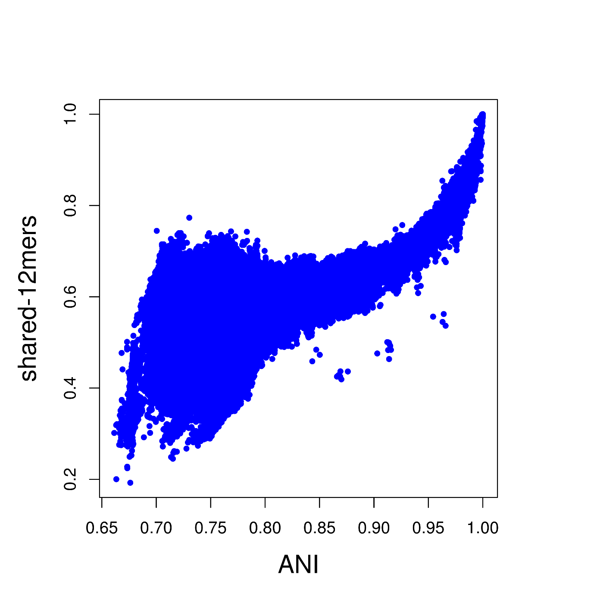
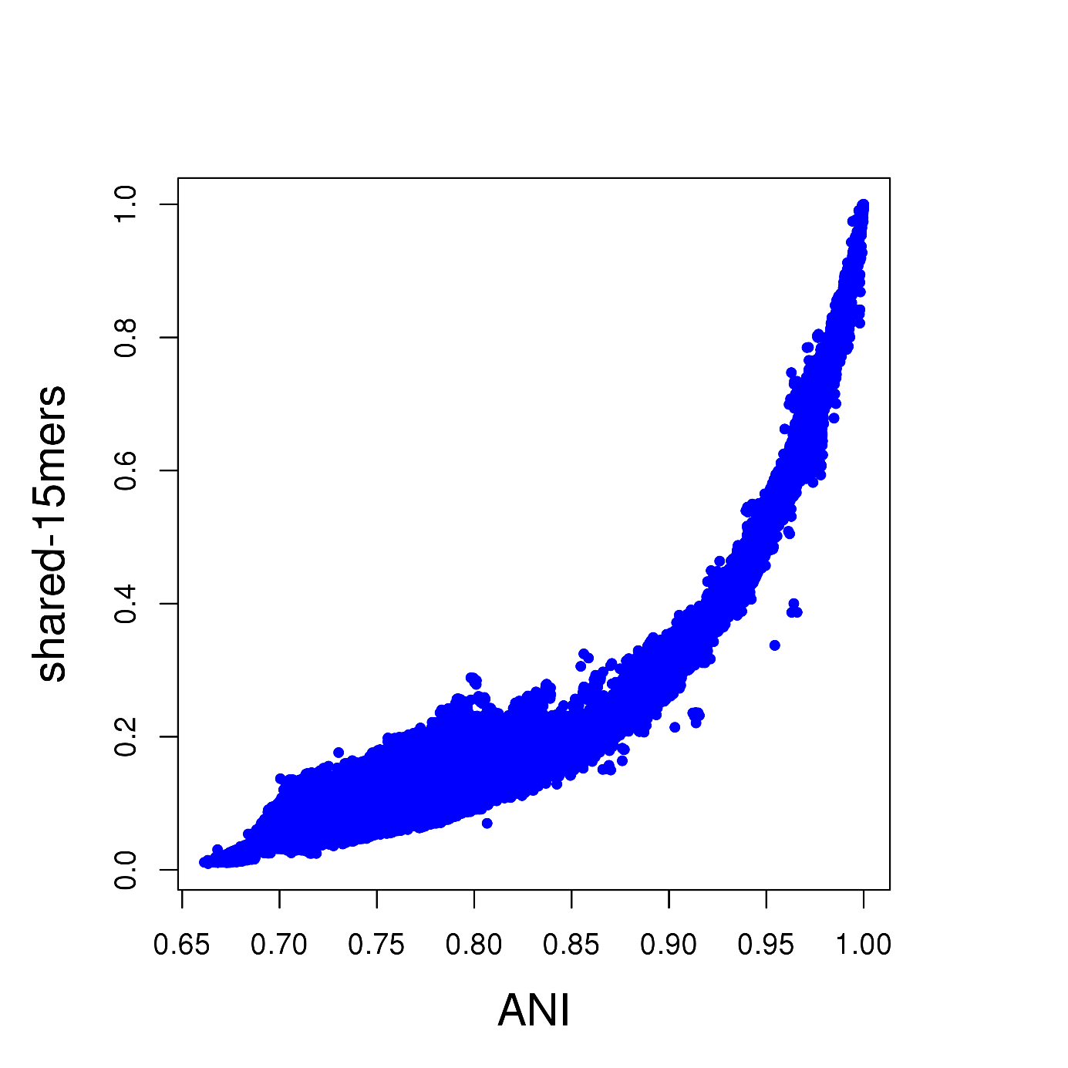
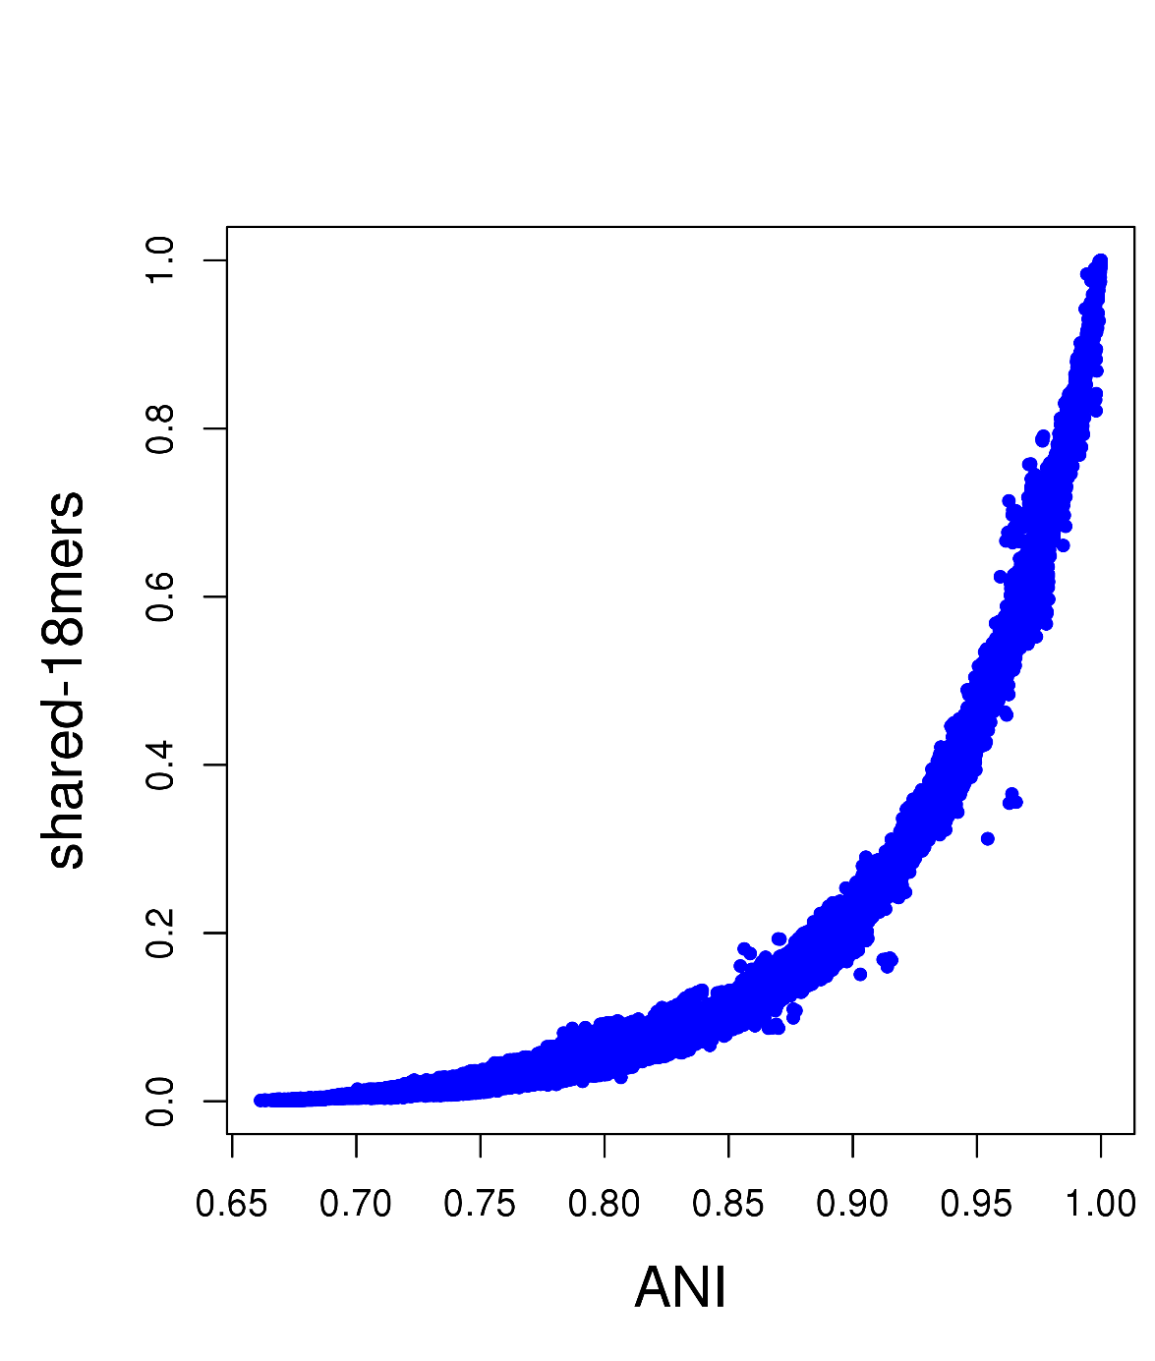
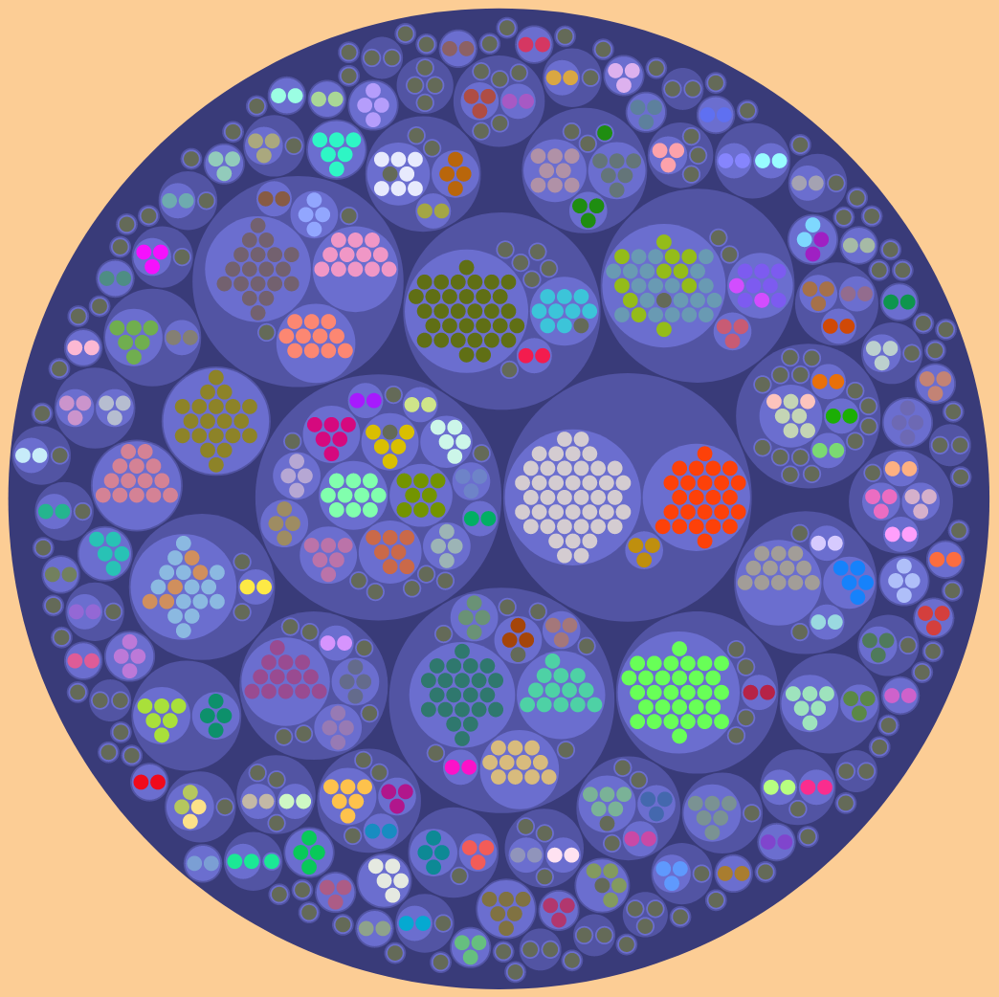
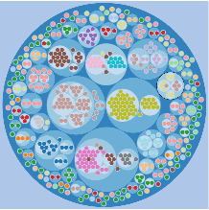
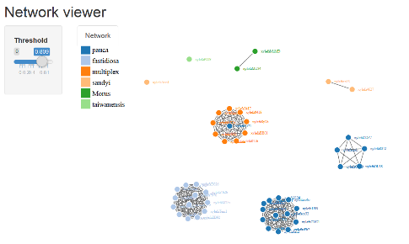
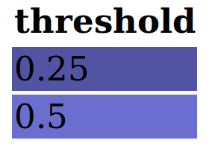
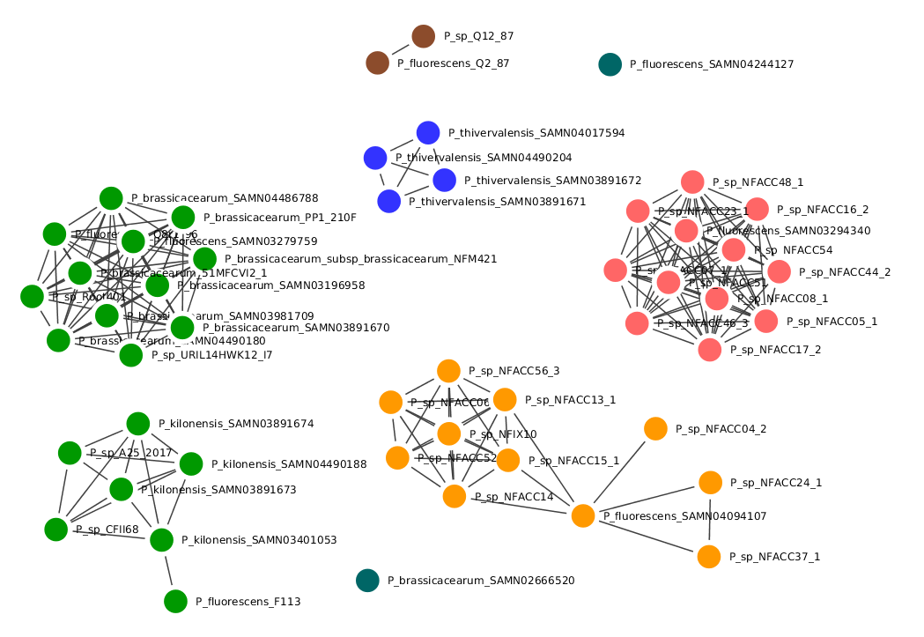
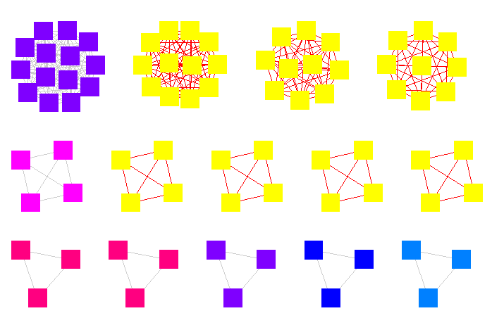
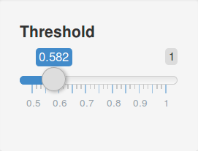
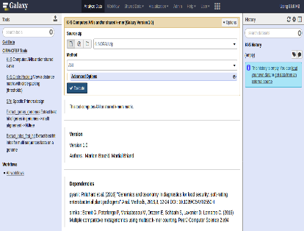
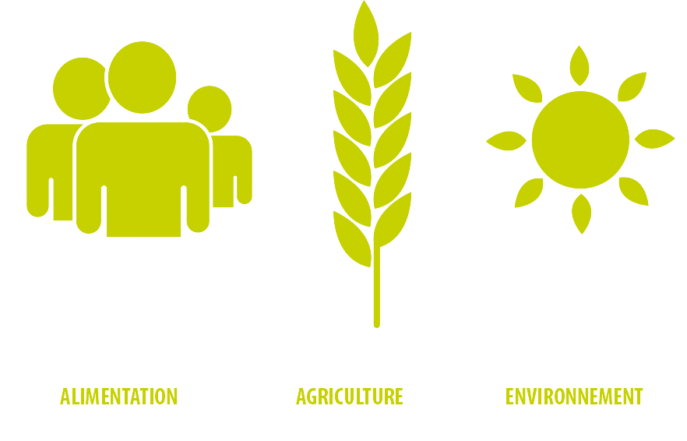
A tool for very fast taxonomic comparison of genomic sequences
Martial Briand ¹, Mariam Bouzid ¹, Marc Legeay ^{1,2}, Marion Fischer-Le Saux ¹, Claire Lemaitre ³, Gilles Hunault ⁴, Matthieu Barret ¹
1 IRHS, INRA, AGROCAMPUS-Ouest, Université d’Angers, SFR 4207 QUASAV , 42 rue Georges Morel, 49071 Beaucouzé cedex, France
2 LERIA - Université d'Angers - Université Bretagne Loire, 2 bd Lavoisier, 49045 Angers, France
3 INRIA, IRISA, GenScale, Campus de Beaulieu, Rennes, 35042, France
4 HIFIH laboratory, Angers University, Bretagne Loire University, Angers, France
https://iris.angers.inra.fr/galaxypub-cfbp/
Un jeu MB
A measure widely used by taxonomists : ANIb (Average Nucleotidic Identity) - Homology search (BLAST)
- Problem : Time-consuming
A very common question :
2 genomes, same species ?
Another Proposal :
Shared K-mers
What are shared k-mers ?
A case study
K-mers = all the possible subsequences (of length K) from a sequence.
944 publicly available Pseudomonas genomic sequences
- ANIs calculation time : 3 months
- Shared K-mers calculation time : 1 hour (10-mers) to 4 hours (20-mers)
Genome
Query
K-mers of
target genome
Comparison between ANIb and shared K-mers values :
K=12
K=15
K=18
Shared
K-mers
Genome
Target
K-mers of
query genome
KI-S pipeline
Comparison of clustering from ANIb and shared 15-mers :
Connected component clustering and circle packing representation :
1 dot represents 1 genomic sequence.
Dots color corresponds to ANIb group ( species threshold = 0.95).
Dots group by connected component clustering of shared 15-mers matrix at thresholds of 0,25 and 0,5.
Conclusion
Groups obtained by clustering on the shared 15-mers values at the threshold 0.5 are very similar with groups obtained by clustering on ANIb values at the species threshold (0,95).
Genomes
fasta files
pyani
simka
ANIb
Shared K-mers
Adjacency matrix creation and visualisation with :
(Similarity matrix)
- R-shiny
For a sub group : representation of adjacency matrix of shared 15-mers :
- Cytoscape
1 dot represents 1 genomic sequence.
A link between genomic sequences is created if the shared 15-mers value is greater than threshold.
Threshold value can be modifed with cursor that creates / supresses link between genomic sequences.
Visualisation tools
Availability
Source code: https://sourcesup.renater.fr/projects/ki-s/
Galaxy interface: https://iris.angers.inra.fr/galaxypub-cfbp/
Conclusions
Shared K-mers is a good estimate of the phylogenetic distance between closely related genomic sequences
Shared K-mers allows very fast taxonomic assignement
Circle packing representation improves visualization of large similarity matrix
References.
Richter, M., Rossello-Mora, R. : Shifting the genomic gold standard for the prokaryotic species definition. Proc Natl Acad Sci USA 106 : 19126-19131. DOI :10.1073/pnas.0906412106 (2009)
Pritchard Leighton and Glover, Rachel H. and Humphris, Sonia and Elphinstone, John G. and Toth, Ian K : Genomics and taxonomy in diagnostics for food security: soft-rotting enterobacterial plant pathogens. Anal. Methods, 2016,8, 12-24. DOI: 10.1039/C5AY02550H (2016)
Benoit G, Peterlongo P, Mariadassou M, Drezen E, Schbath S, Lavenier D, Lemaitre C. : Multiple comparative metagenomics using multiset k-mer counting. PeerJ Computer Science 2:e94. DOI : 10.7717/peerj-cs.94 (2016)
^{IRHS, 42 rue Georges Morel}
⁴⁹⁰⁷¹ ^{Beaucouzé, France}
^{Tél. : + 33 2 41 22 57 29}
^{Fax : + 33 2 41 22 57 55}
^{martial.briand@inra.fr}

